Slide 1
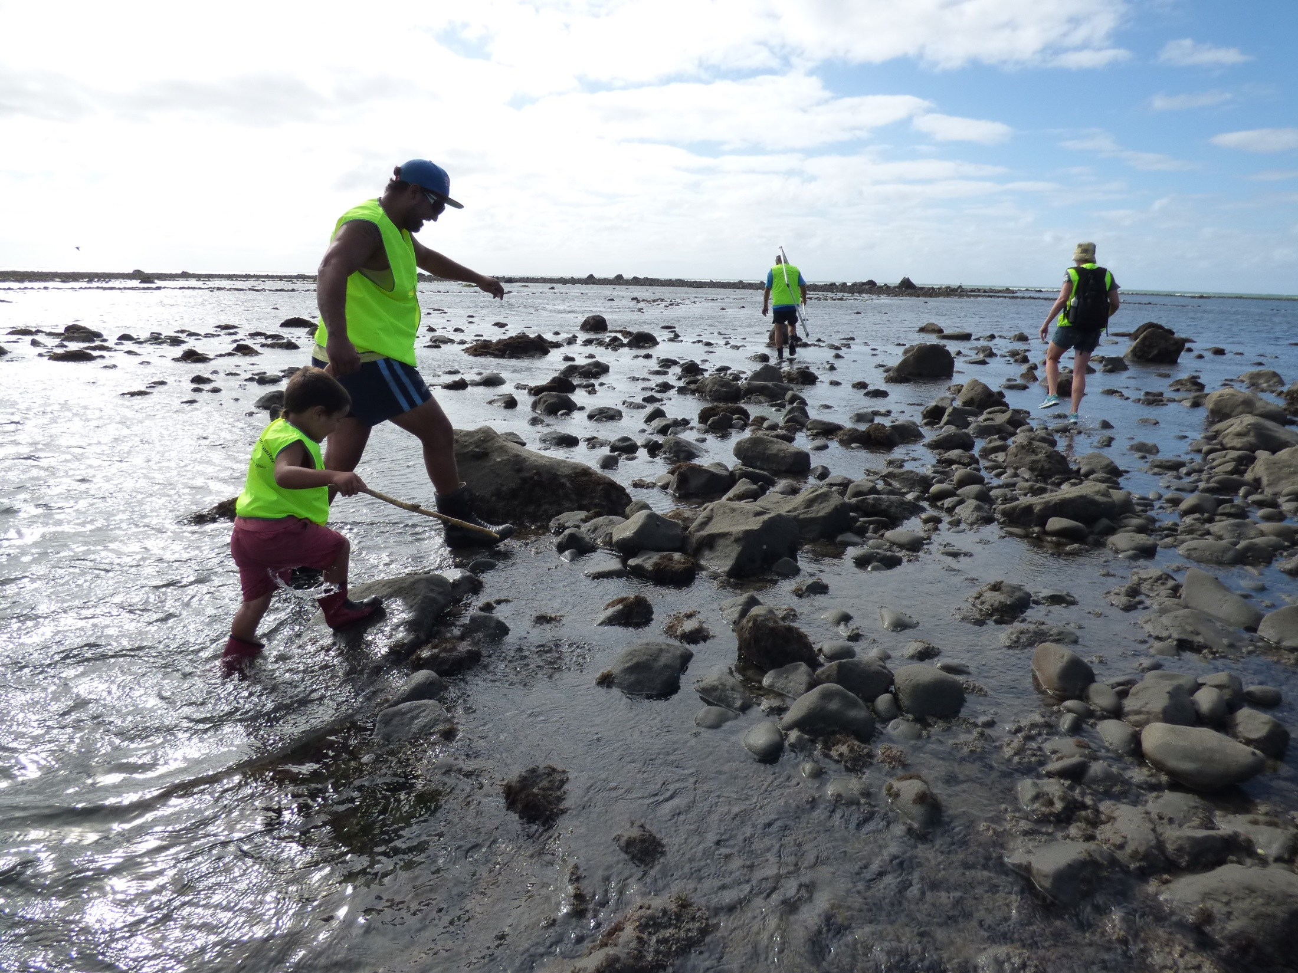
New Zealand
Science & tech literacy are fundamentally important to the future of young New Zealanders
Country Coordinator Victoria Metcalf

Slide 2
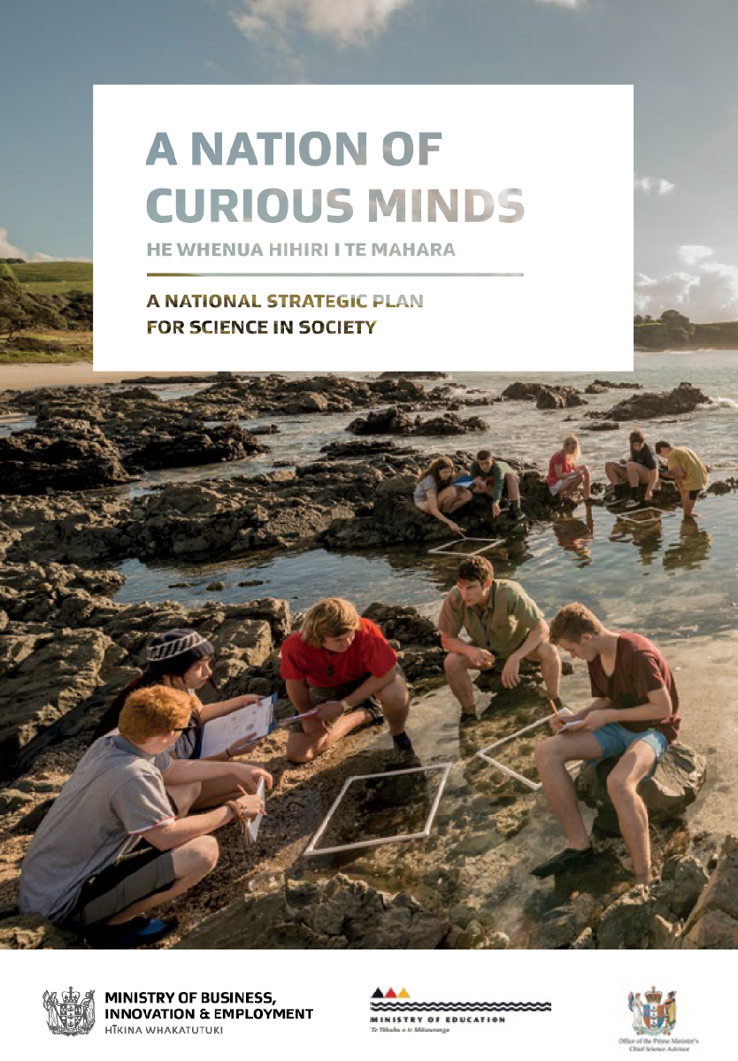
Notes:
Vision: Why was the Plan launched? A high-performing and responsive science and innovation system is vital for New Zealand’s economic, social and environmental wellbeing. Businesses need to be able to create, absorb and apply new approaches and ideas to increase productivity and provide competitive new products. To do this, we need a greater number of New Zealanders with the skills to support creativity, innovation and knowledge uptake and use. Policymakers need to be aware of the contribution scientific research can make to robust policies that support our social and environmental advancement.

Slide 3
Cooperating organisations
Office of the Prime Minister’s Chief Science Advisor
US Consulate and Embassy
(Ministry of Education)
(Science Learning Hub)

Slide 4
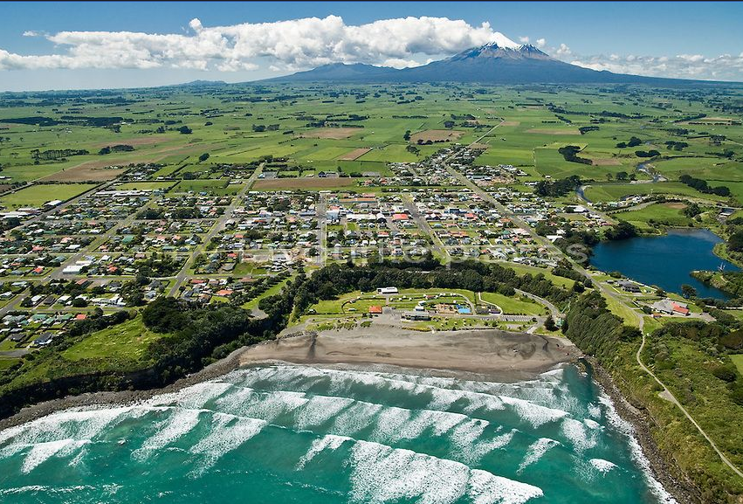
Schools
222 schools listed; 112 not yet reporting, 109 have reported in the past.
Out of 222 schools identified on the GLOBE website and 67 teachers, there were 81,914 observations made.
1 active school:Opunake High School (15,759 observations)
Collaboration with overseas (Utajärvi, Finland)

Slide 5
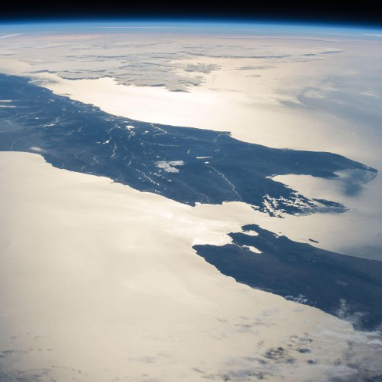
Protocols used
A range covering Atmosphere, Hydrology, and Pedosphere protocols
Atmosphere protocols >
Hydrology

Slide 6
New Zealand activities
Emails to New Zealand teachers registered with GLOBE
Use of networks to inform about GLOBE
272 untrained observers (registered with the GLOBE Observer App)
4 GLOBE trainers
GLOBE trainers are interested in conducted trainings. e.g. Murray Palmer, Nga Mahi Te Taiao (Environment and Natural Resources Research Education Planning Development, Turanganui a Kiwa):
“I’m very keen to explore reinvigorating GLOBE here in Tairawhiti, particularly around coastal processes and atmospheric studies.”
“I had been hoping to run some small training workshops as part of our ‘barefoot scientists’ program, but ran out of time and resources”

Slide 7
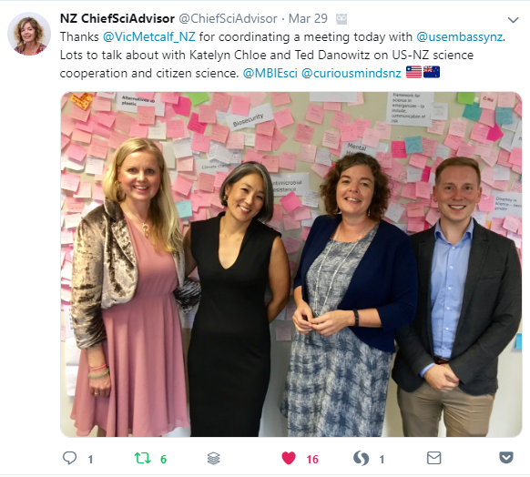
US Embassy and Consulate
Engaging with:
Katelyn Choe (Consul General),
Ted Danowitz (Political-Economic Officer) and Philip McKenna (Politcal-Economic),
Lauren Murray and Natalie Wilkins (Public Affairs),
Mara Hosoda (Science).

Slide 8
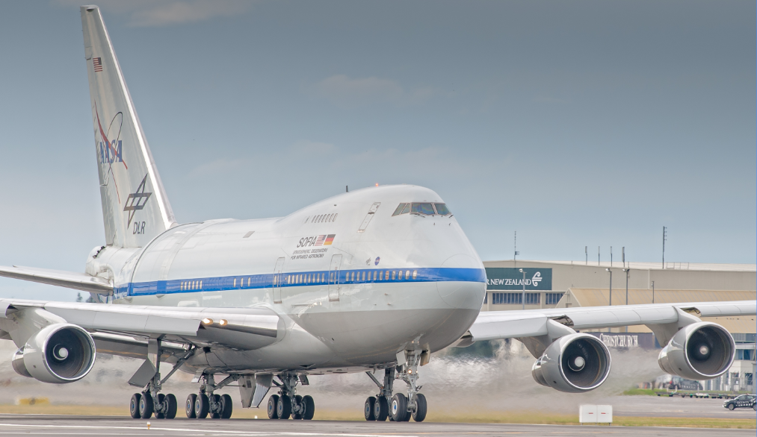
US Embassy and Consulate
Applying for an Embassy small grant to enable us to hold a GLOBE training session (possibly CMT), sometime between July-Sep;
Investigating with ChristchurchNZ (regional development and tourism agency) whether we can have a GLOBE presence at the SOFIA open day July 20;
Cross promotion of GLOBE with other NASA activities: e.g SOFIA plane, IAP speaker programme, visiting distinguished scientists (e.g. Prof Osterholm (public health scientist and infectious diseases expert));
Support letter from the Embassy to the Ministry
of Education regarding GLOBE.
Linking to the Royal Society;

Slide 9
Government Meetings
Finalizing a draft briefing document for the Ministry of Education and a formal request for their support via promotion and funding;
Liaison with the Ministry over drafting a story on GLOBE for the Education Gazette (sent to all schools in New Zealand);
Contact the New Zealand Association of Science Educators regarding support for GLOBE.

Slide 10
GLOBE New Zealand Advisory Group
Murray Palmer, a GLOBE trainer, and John Lockley (former CC) = Assistant Coordinators.
A GLOBE New Zealand strategic team has been formed:
4 GLOBE trainers (including Murray Palmer, as well as Elise Smith, Andrew Innes, and Adie Leng),
representatives from the Science Learning Hub (government funded online education resource provider administered by the University of Waikato; representative Andrea Soanes),
the Royal Society (science education representative Jessie McKenzie),
and environmental educators and scientists, including John Lockley (former CC) and Andrew Hornblow.
Current actions:
Next steps = workshop of interested parties, local trainings, other partners (Department of Conservation, Enviroschools network, New Zealand Association of Science Educators).
Creation of a pilot school list
Publication of STAR articles

Slide 11
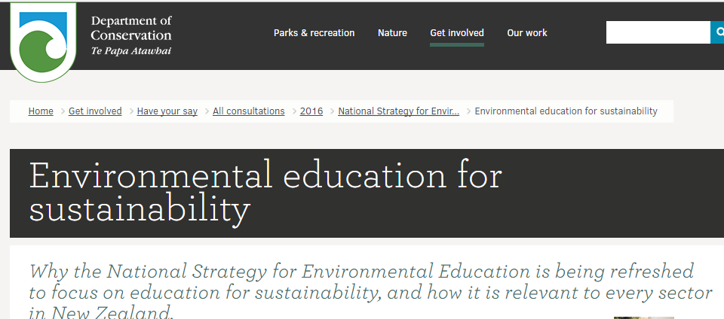
Environmental education
Department of Conservation has a recently updated EEfS strategy

Slide 12
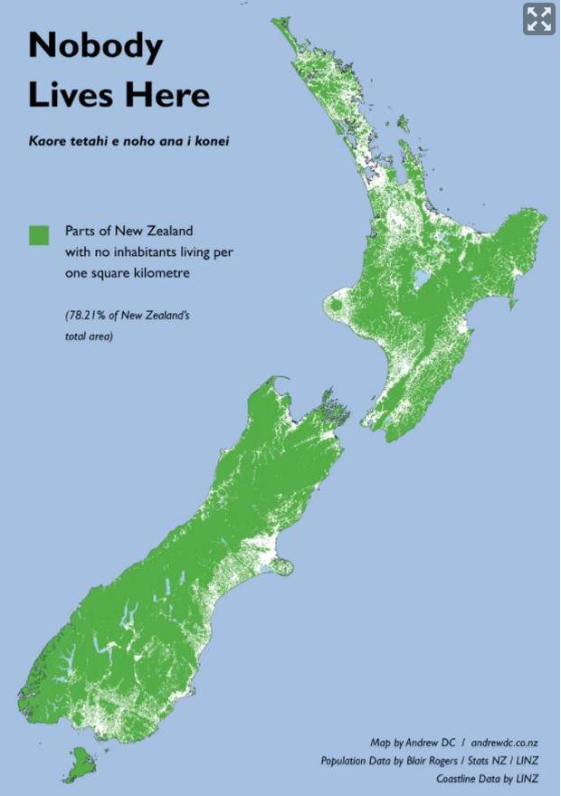
Potential partners
Ministry of Education
Department of Conservation
Ministry of Business, Innovation & Employment
Ministry for the Environment
NZ Association of Science Educators
Royal Society
Enviroschools
Mountains to Sea Conservation Trust
Christchurch NZ
Te Papa Museum mosquito citsci project

